Slide 1

Codeflix
Analysis of churn rates
By Paul Foreman

Slide 2
Contents
1. Get familiar with the company.
How many months has the company been operating? Which months do you have enough information to calculate a churn rate?
What segments of users exist?
2. What is the overall churn trend since the company started?
3. Compare the churn rates between user segments.
Which segment of users should the company focus on expanding?
4. Conclusions

Slide 3
1.1 What data do we have?
id | subscription_start | subscription_end | segment
1 | 2016-12-01 | 2017-02-01 | 87
2 | 2016-12-01 | 2017-01-24 | 87
3 | 2016-12-01 | 2017-03-07 | 87
4 | 2016-12-01 | 2017-02-12 | 87
There are four key pieces of data available:
A unique user identifier;
the date of subscription start;
the date the subscription was canceled (if they are no longer Codeflix members).
A segment code

Slide 4

1.2 Investigating data further
The company has been in operation for four months, and data is available from December 1, 2016 through March 30, 2017.
As customers are committed to a minimum contract period of one month, there is sufficient data for 3 months (January 2017 – March 2017)
There are two separate segments of customers (segment 30 and segment 87
first_data_point_date | latest_data_point_date
2016-12-01 | 2017-03-30
segment
30
87

Slide 5
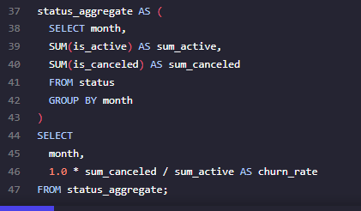
2.1 What is the overall churn rate since the company started?
month | churn_rate
2017-01-01 | 0.161687170474517
2017-02-01 | 0.189795918367347
2017-03-01 | 0.274258219727346
Overall churn rate by month is between 16.17% in January, rising to 27.43% in March

Slide 6
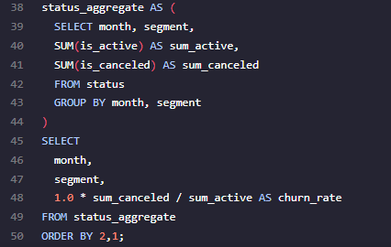
3.1 Calculating churn rate by customer segment
month | segment | churn_rate
2017-01-01 | 30 | 0.0756013745704467
2017-02-01 | 30 | 0.0733590733590734
2017-03-01 | 30 | 0.11731843575419
2017-01-01 | 87 | 0.251798561151079
2017-02-01 | 87 | 0.32034632034632
2017-03-01 | 87 | 0.485875706214689
Segment 30 shows a much lower churn rate of between 7.56% and 11.73%
Segment 87 shows a churn rate of 25.18% to 48.59%

Slide 7
4.1 Conclusions
Churn rates for segment 30 are substantially lower in each month, resulting in a higher customer lifetime value attributable to this segment.
Assuming customer acquisition costs between segments are comparable and the customer lifetime value exceeds acquisition cost, then marketing dollars should be focused on segment 30.

